Slide 1

CLIX: Convenient Living & Integrated Experience
Smart Utility Management for Bangladesh
Transforming electricity, water, and gas infrastructure with IoT and AI

Slide 2
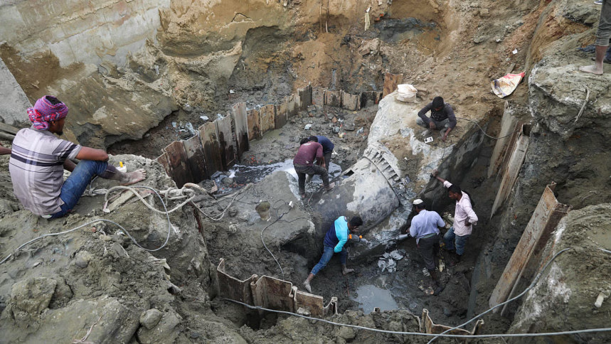
The Problem - Critical Infrastructure Losses

Slide 3
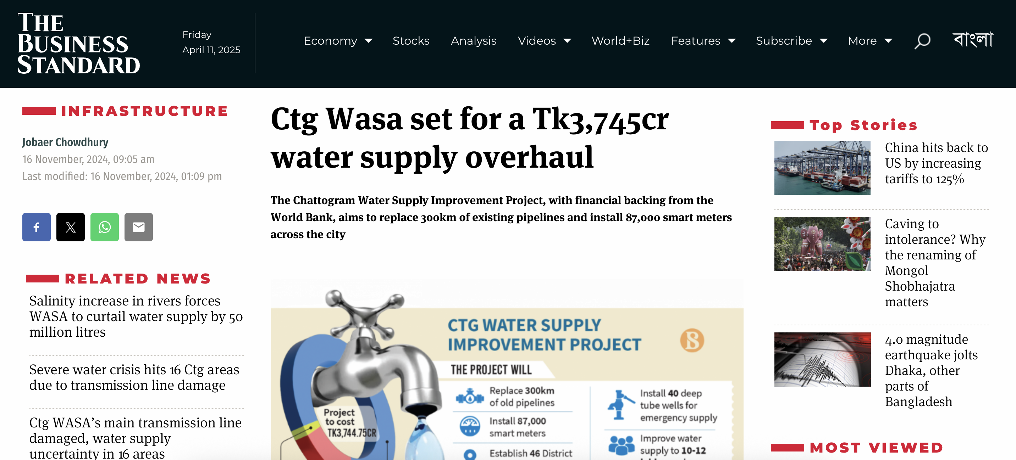
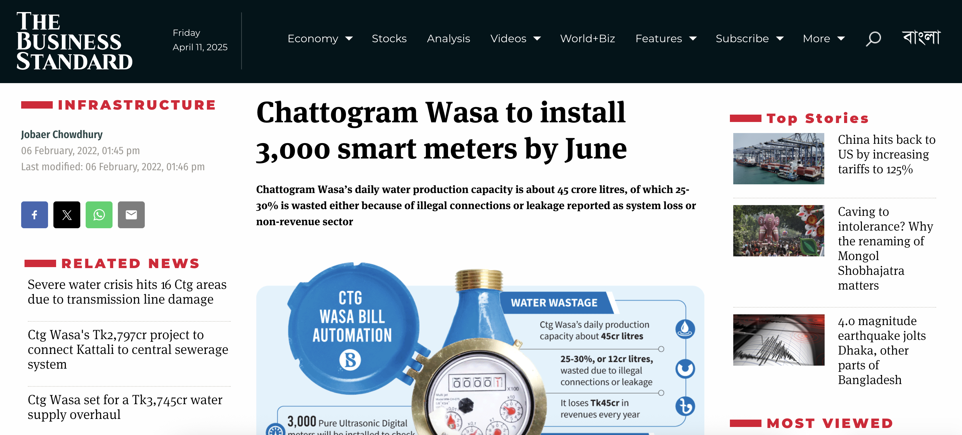
Water Supply Crisis
"Chattogram WASA experiences 25-30% non-revenue water loss, much higher than the global standard of less than 5%" (The Business Standard, 2024)
"A loss of Tk14-17 crore worth of water every month" (The Business Standard, 2024)
"42 Meter Inspectors for 78,000 connections" leads to inaccurate readings (The Business Standard, 2022)

Slide 4
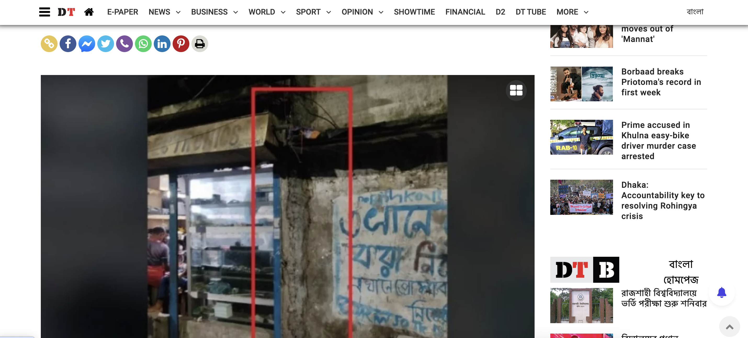
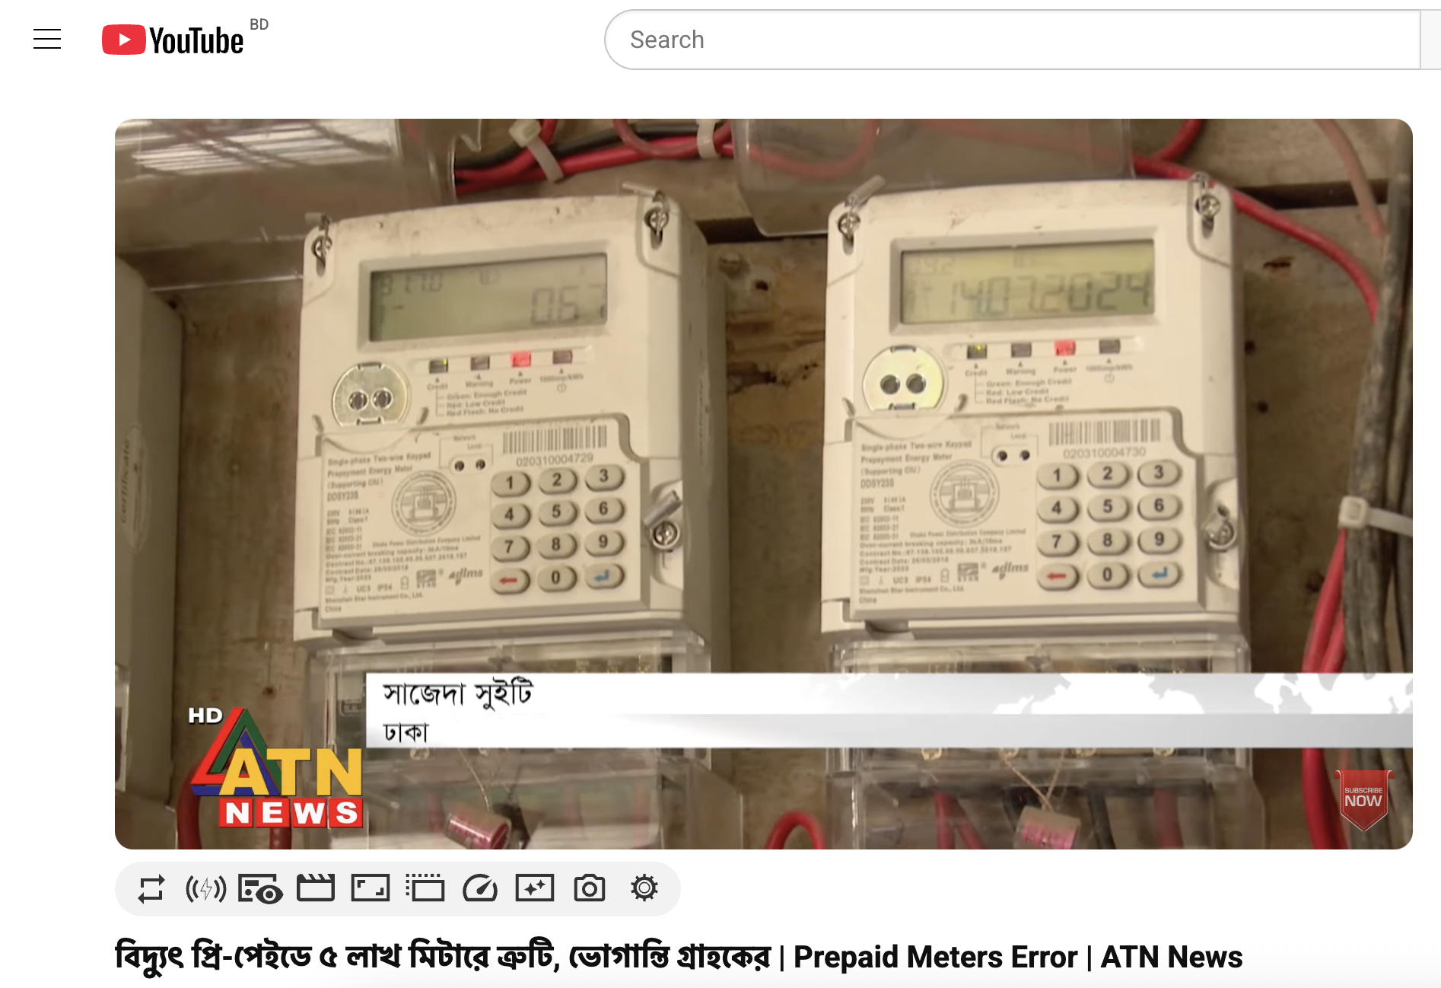
Electricity Distribution Failures
"5 lakh defective meters out of 3.5 crore" nationwide (ATN News - Jul 16, 2024)
Elderly users struggle with "token codes with over 100 digits" (CLIX exclusive interview)
"Four people were electrocuted when the power cable fell into the waterlogged area in Mirpur" (DhakaTribune, 2023)

Slide 5
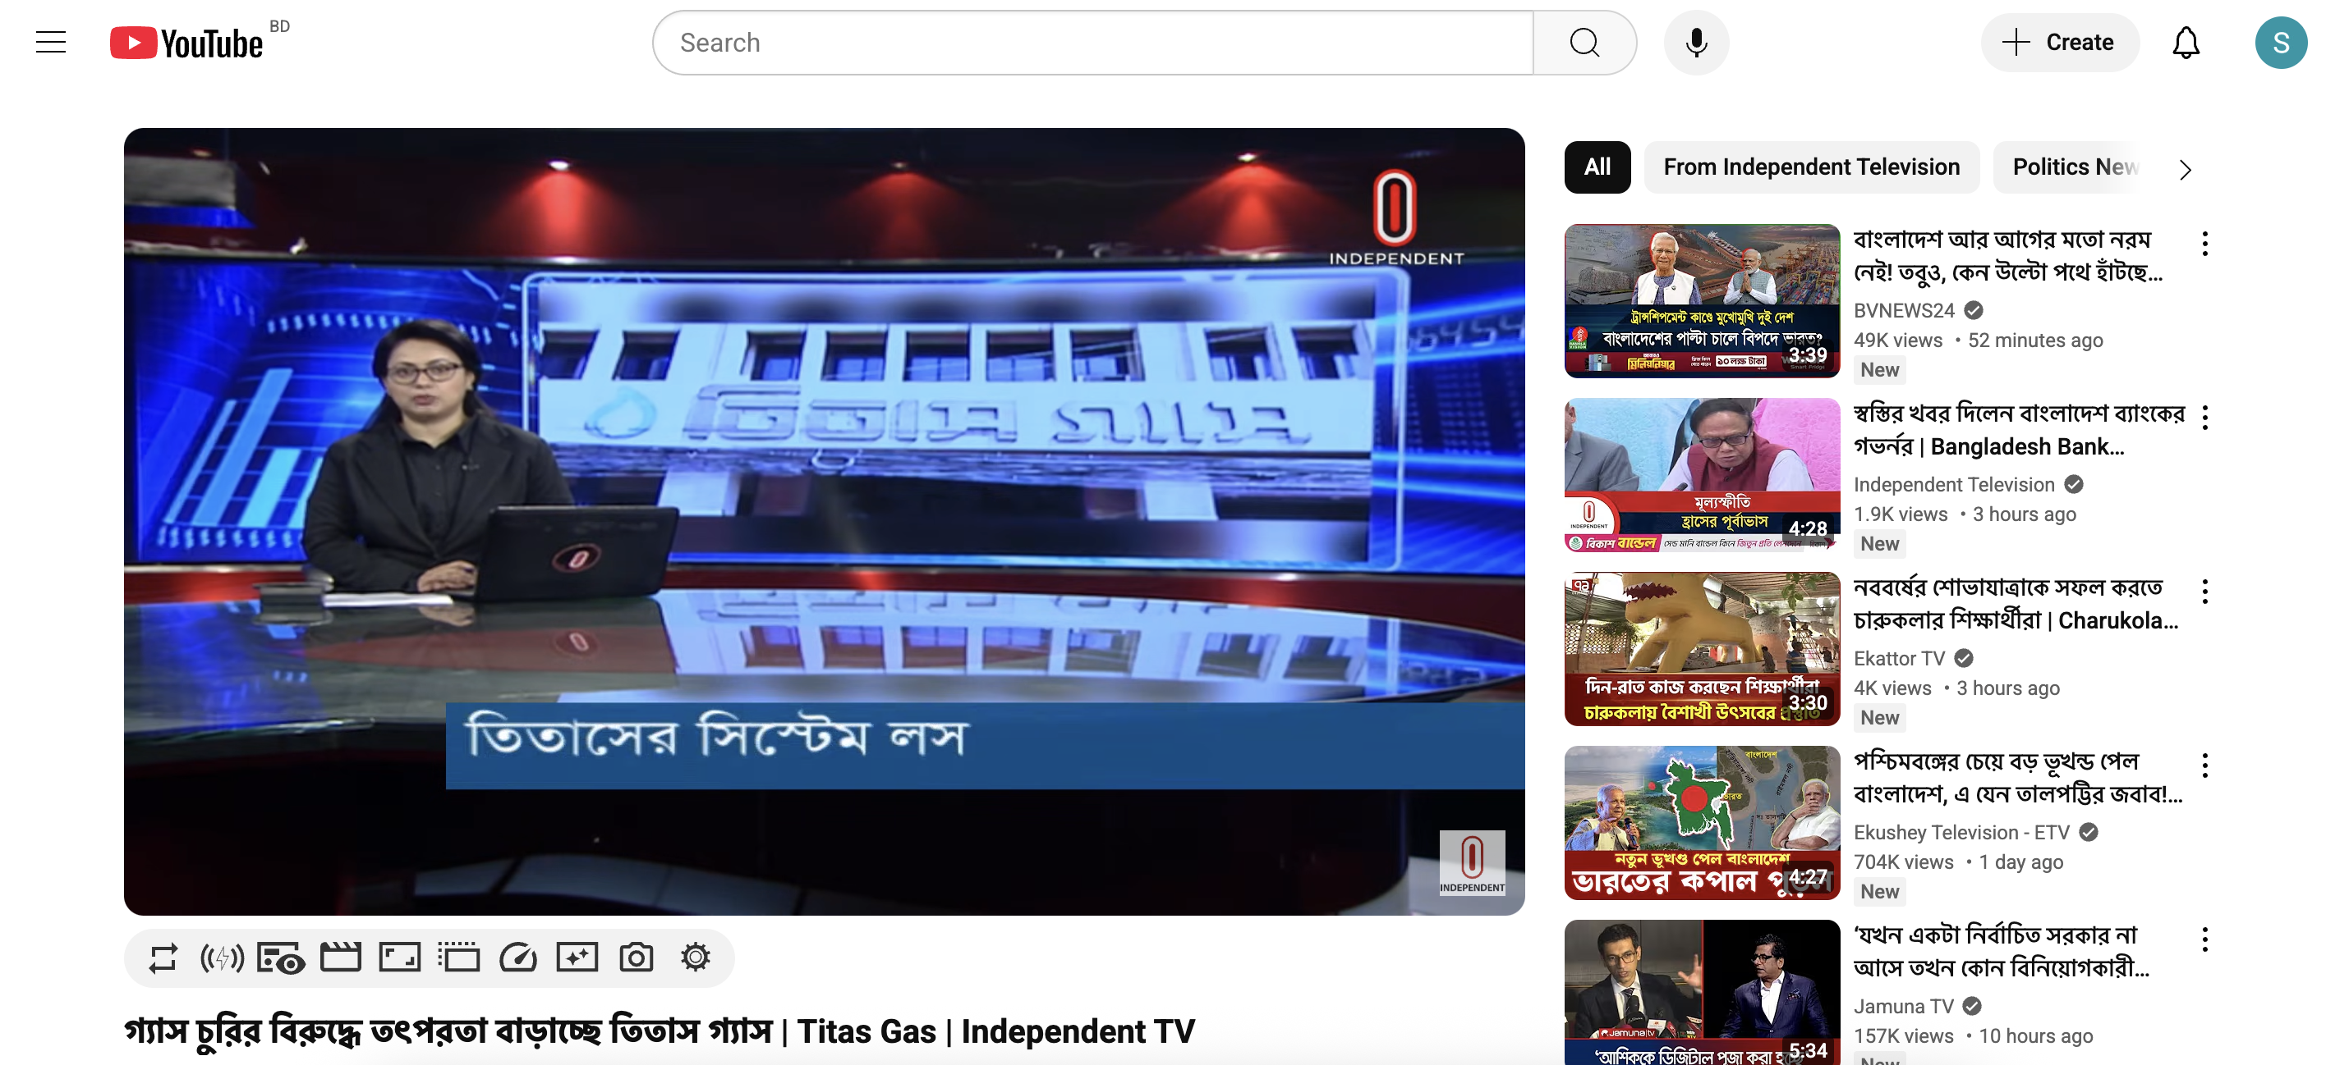
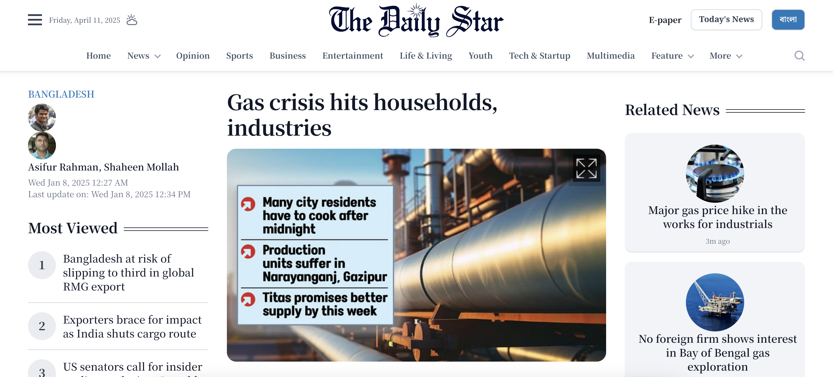
Gas System Inefficiencies
Titas Gas reported system losses of "7.67%, where BRC standardized 2%" (Independent TV, 2025)
Losses costing "3000 Cr BDT annually" (Independent TV, 2025)
Factories "cutting production by almost a third" due to inadequate gas pressure (Daily Star, 2025)

Slide 6
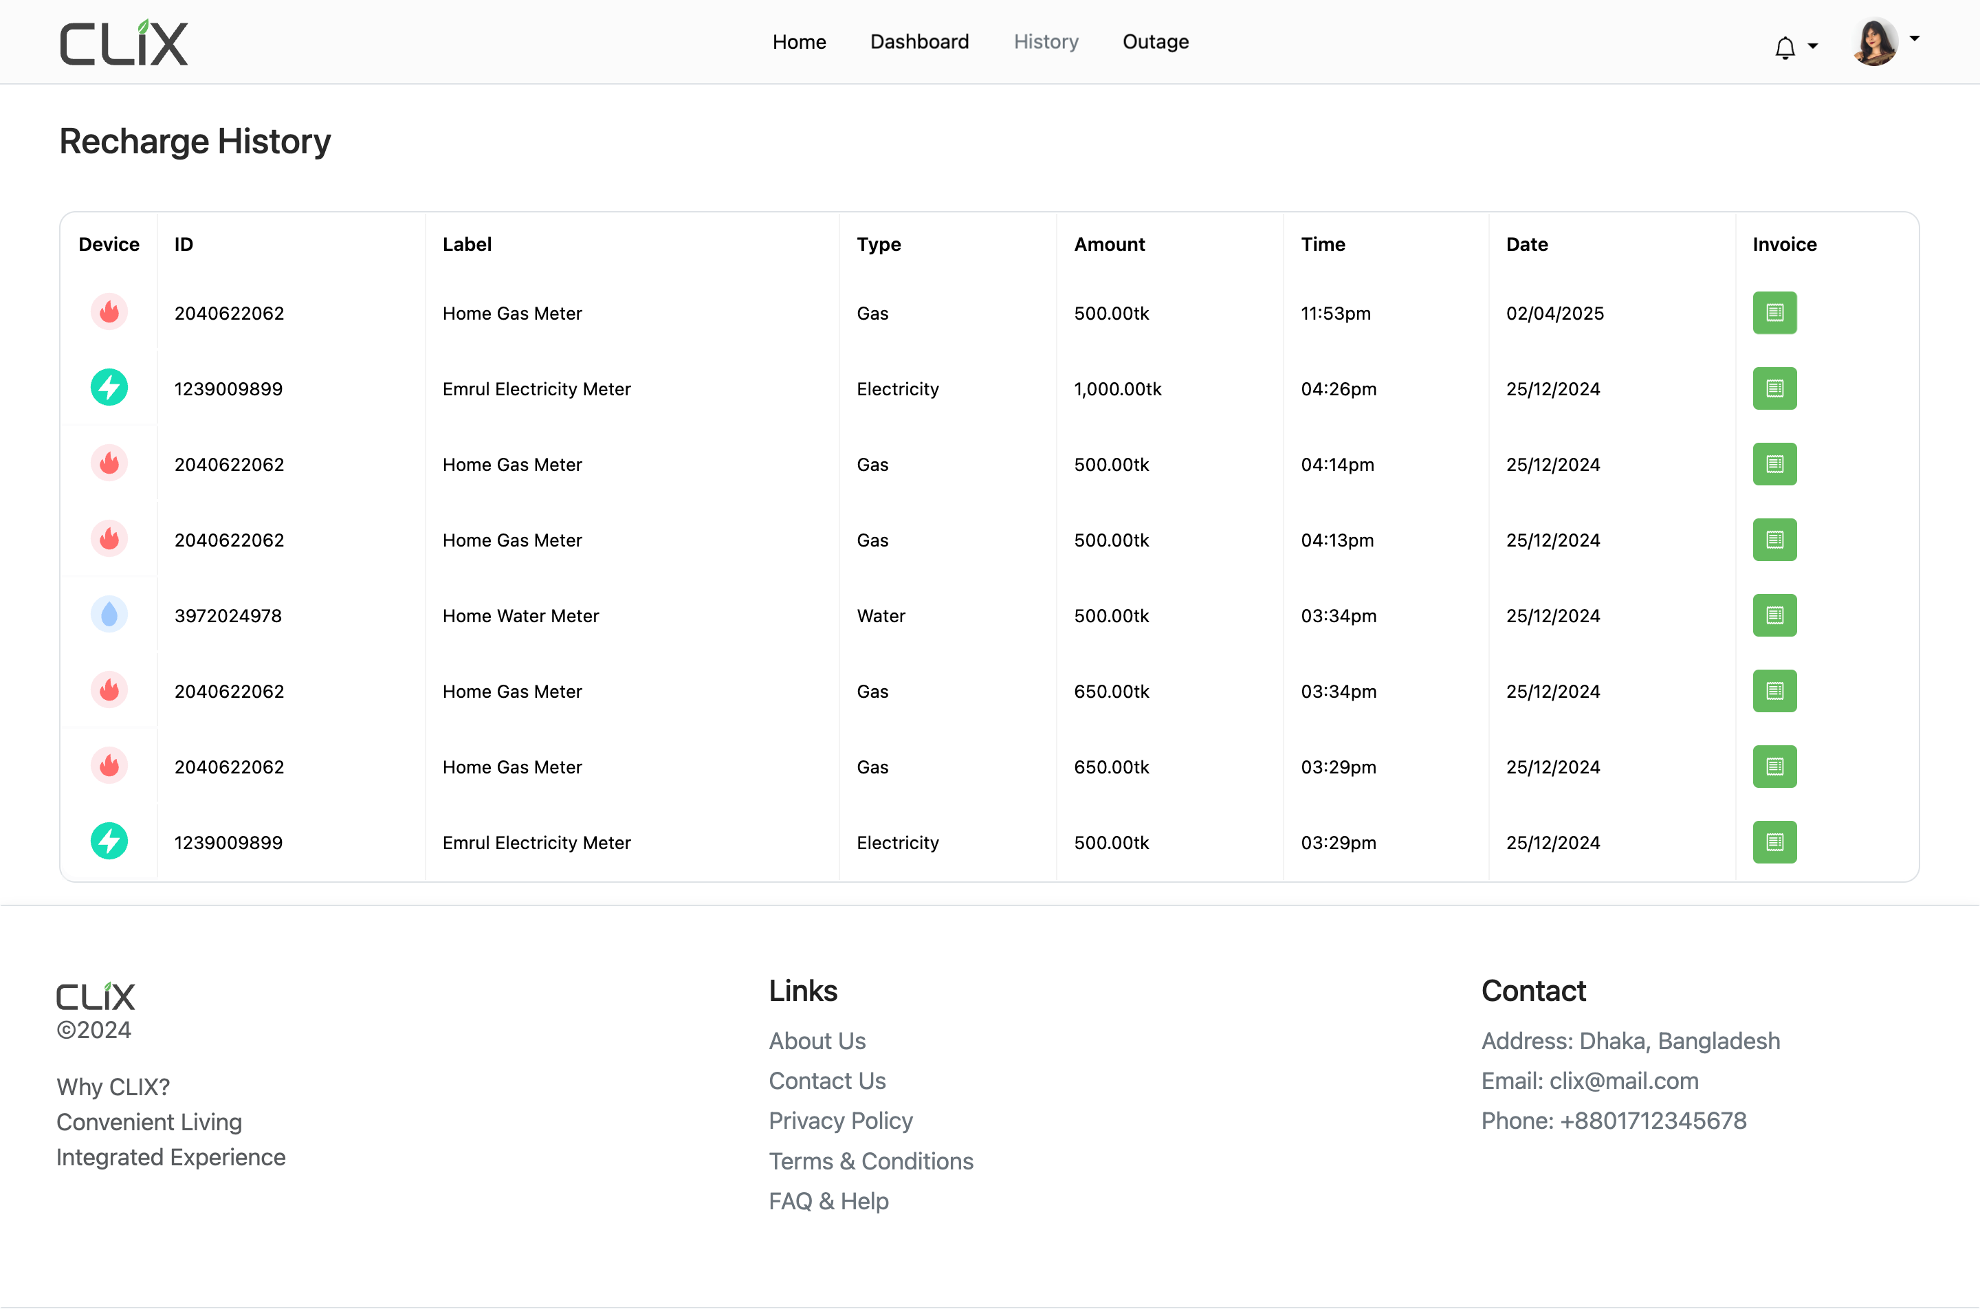
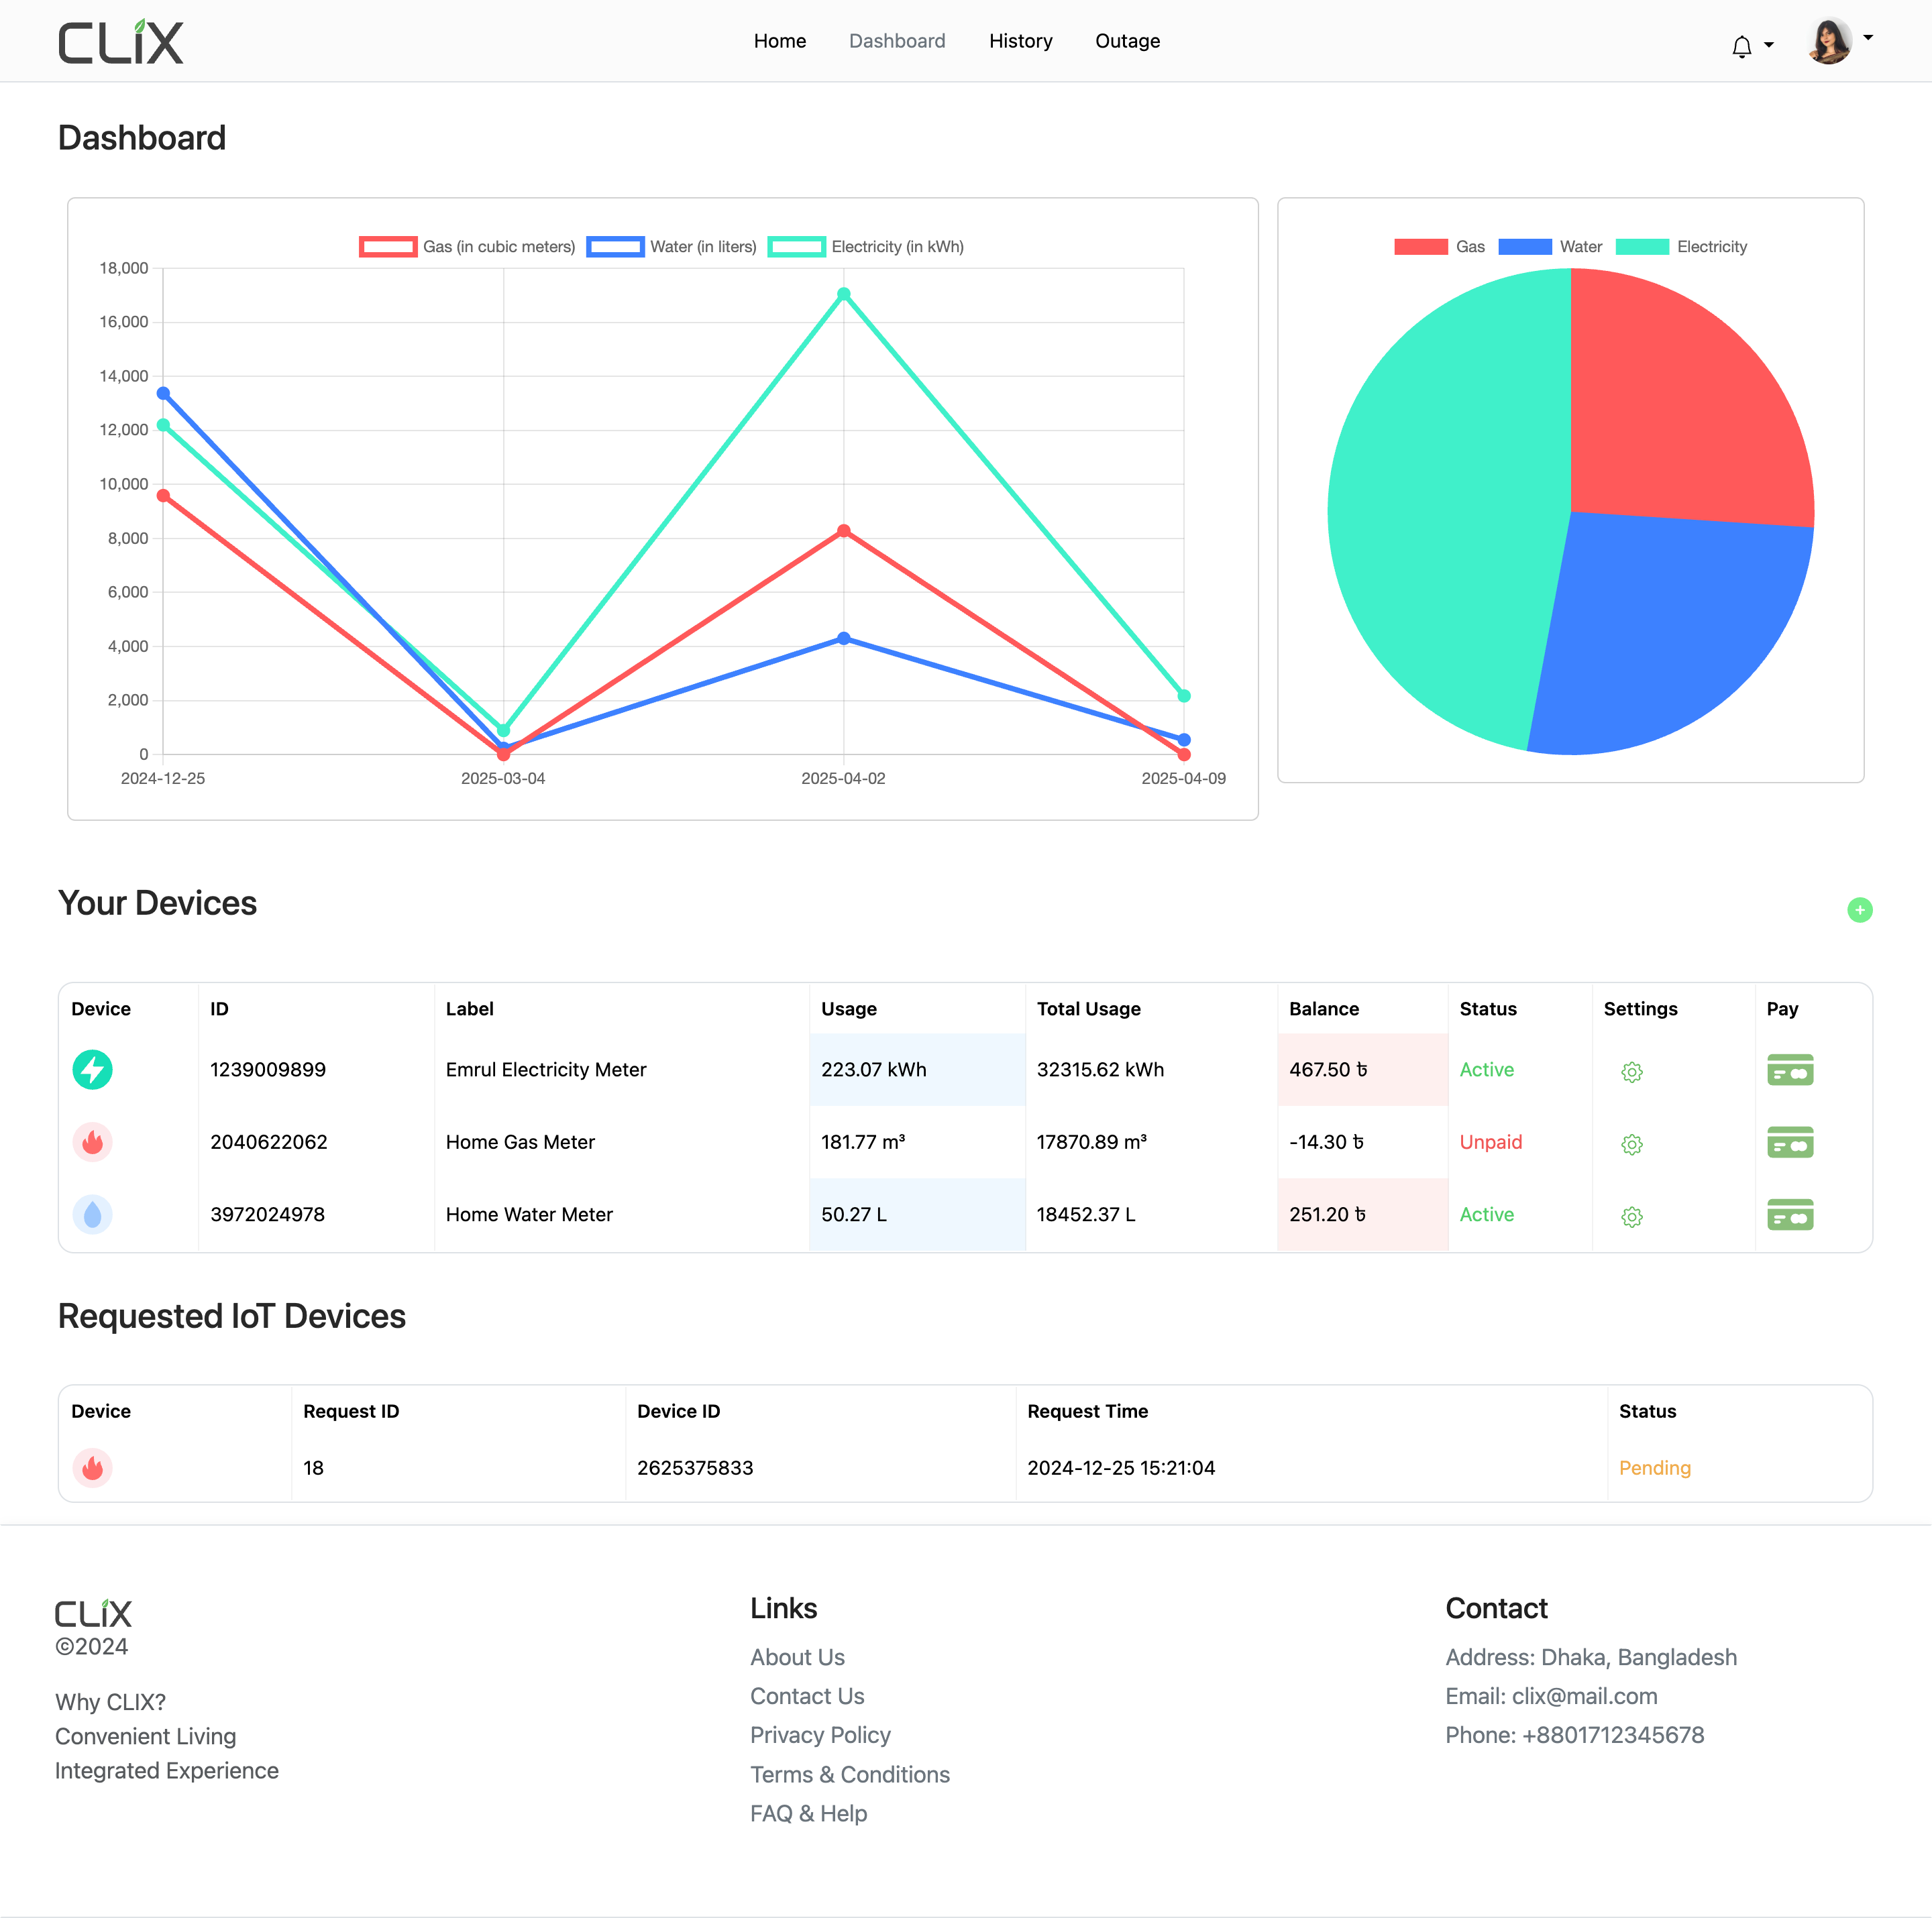
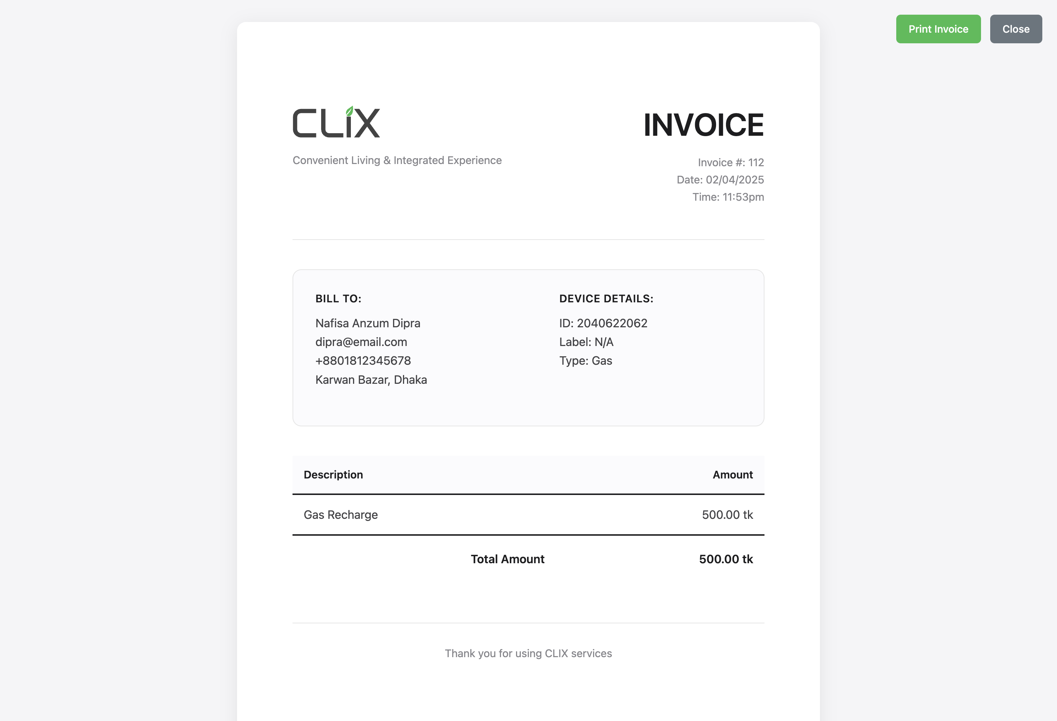
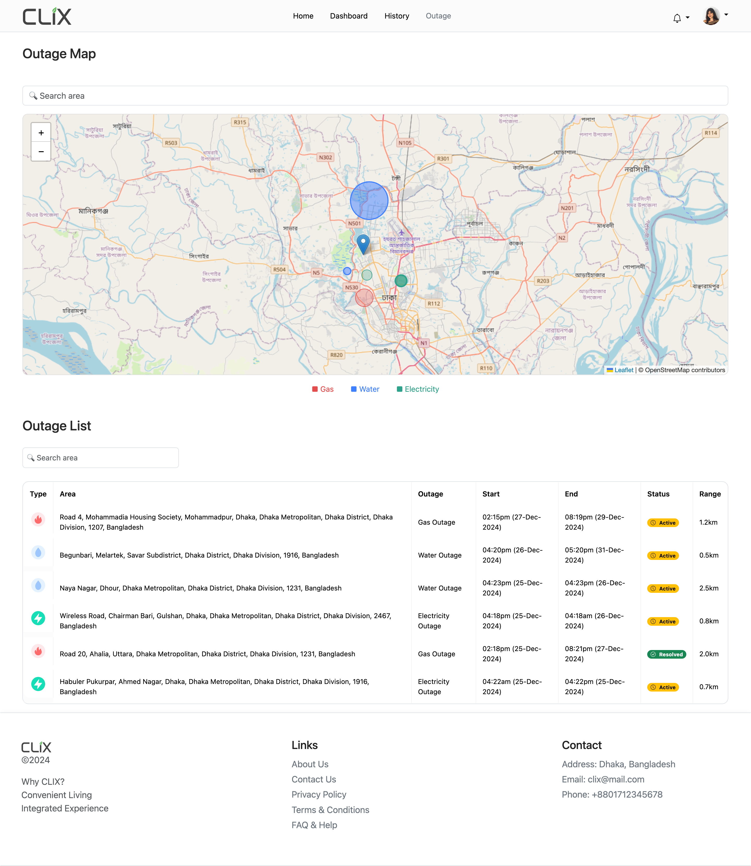
The Solution: CLIX (Convenient Living & Integrated Experience)

Slide 7
CLIX Overview
Integrated Technology Platform:
LoRaWAN-enabled smart meters with tamper detection and AES-128 encryption
Unified management dashboard for real-time monitoring across all utilities
AI-driven analytics for leak detection, theft identification, and equipment failures
Multi-channel payment integration with mobile banking options
Real-time outage management with push notifications
Multi-language consumer portal with usage tracking
Key Objectives:
Reduce non-revenue losses across all utilities
Implement automated meter reading and billing systems
Enhance service reliability through predictive maintenance
Create a unified platform for all utility management

Slide 8
Dashboard

Slide 9
Outage Map

Slide 10
Recharge History

Slide 11

Now What is AND Why LoRaWAN?

Slide 12
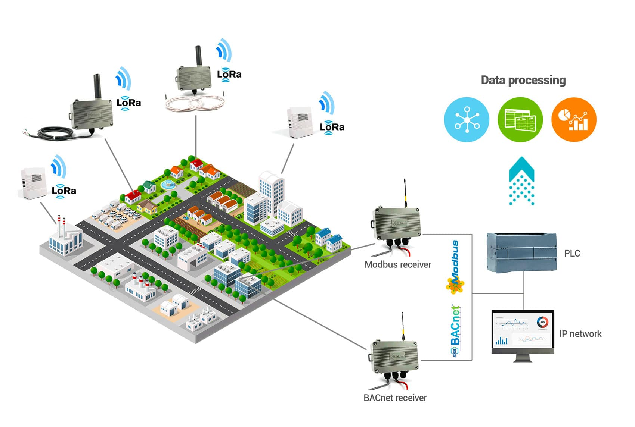
What is AND Why LoRaWAN?
LoRa, short for Long Range Radio, is a wireless communication technology designed for low-power, long-range data transmission, primarily used in IoT and M2M applications. Unlike Wi-Fi or Bluetooth, LoRa uses Chirp Spread Spectrum (CSS) modulation, which spreads a narrowband signal over a wider channel bandwidth to achieve remarkable range and resilience against interference.
LoRaWAN is the networking protocol built on LoRa that:
Enables devices to communicate over long distances (10-15km) with minimal power consumption
Provides ultra-low energy consumption allowing devices to operate for up to 10 years on a single battery
Implements secure communication protocol with AES-128 encryption for end-to-end data protection
Operates on license-free spectrum, eliminating ongoing frequency licensing costs
Supports thousands of devices per gateway with minimal infrastructure
Enables secure bi-directional communication for large-scale IoT deployments

Slide 13
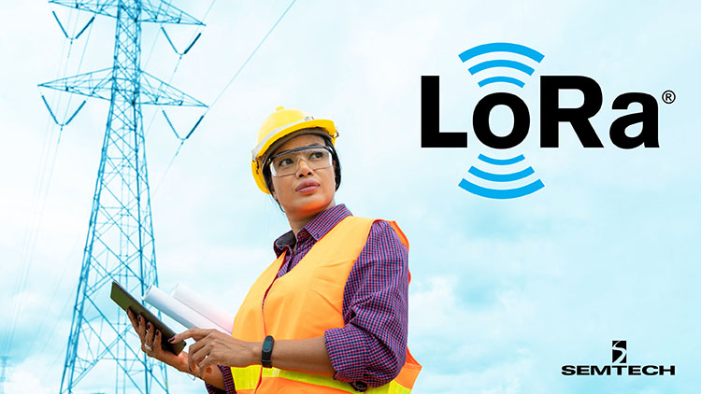

Applications of LoRa Worldwide
Indonesia: Singapore-based Sindcon is retrofitting 50,000+ smart meters in Jakarta with STM32WLE5 LoRaWAN microcontrollers, enhancing remote meter reading in diverse environments while providing 10-year battery life. (The GPS Time, 2023)
Singapore: Sindcon achieved 90%+ data success rates and up to 7-year battery life with their LoRaWAN smart meters, significantly improving utility management efficiency. (Smart Energy, 2025)
Switzerland: Elvexys and Oiken implemented LoRa-enabled sensors for real-time power grid fault detection, reducing deployment costs by 90% compared to traditional methods. (Semtech, 2021)
France: CAHORS Group's Sentinel® line fault detection solutions use LoRaWAN to monitor power lines, enabling immediate fault identification and preventing costly outages. (Semtech, 2019)

Slide 14
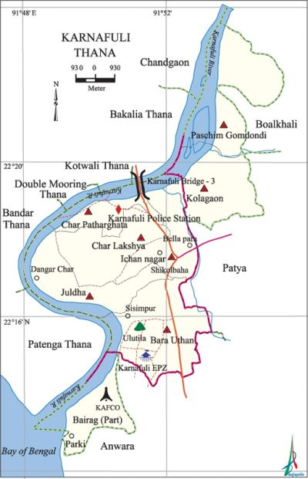
Proven Evidence of LoRa Success in Bangladesh
Chattogram WASA Pilot:
"3,000 Pure Ultrasonic Digital meters (LoRa)" already implemented (The Business Standard, 2022)
"With digital meters no one can tamper with it nor can steal. Also all the bills will automatically come to their server." (Md Samsul Alam, Deputy Managing Director, Chittagong Wasa – Independent TV)
Karnaphuli Water Supply Project:
Successfully "reduced non-revenue water to 10%" (The Business Standard, 2024)
"The Karnaphuli Service Area... with DMA system providing uninterrupted supply to 46,000 connections" (The Business Standard, 2024)
WASA Official Assessment:
"Hopefully, if the project is successfully implemented, water wastage will be prevented and Chattogram Wasa's revenue will increase." (Maksud Alam, Chief Engineer, The Business Standard, 2022)

Slide 15
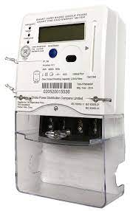
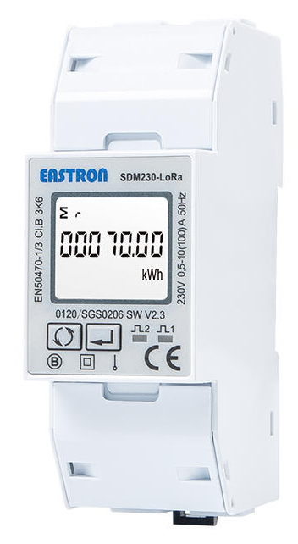
Transforming Bangladesh's Utility Management with LoRaWAN
Current Challenges
5.72% losses in electricity. (DESCO Annual Report 2023)
Limited effectiveness of current GSM-based communication systems
LoRaWAN Solution
Long-range connectivity ideal for urban and rural deployment
Battery life of 7-10 years reducing maintenance costs
90%+ data transmission success rate as proven in Singapore (Smart Energy, 2025)
Cost-effective deployment (up to 90% savings vs. traditional methods)
Real-time monitoring enabling immediate fault detection and prevention

Slide 16
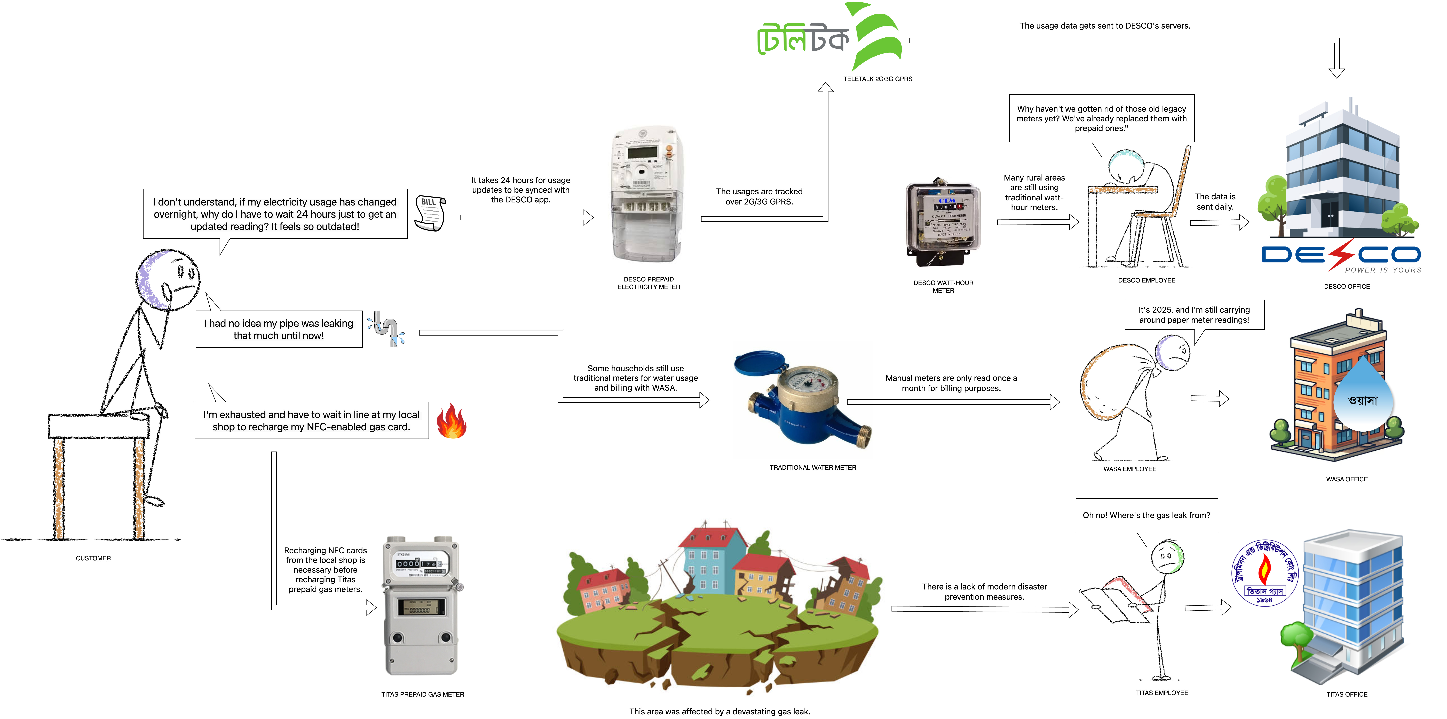
As Is System

Slide 17
To Be System

Slide 18
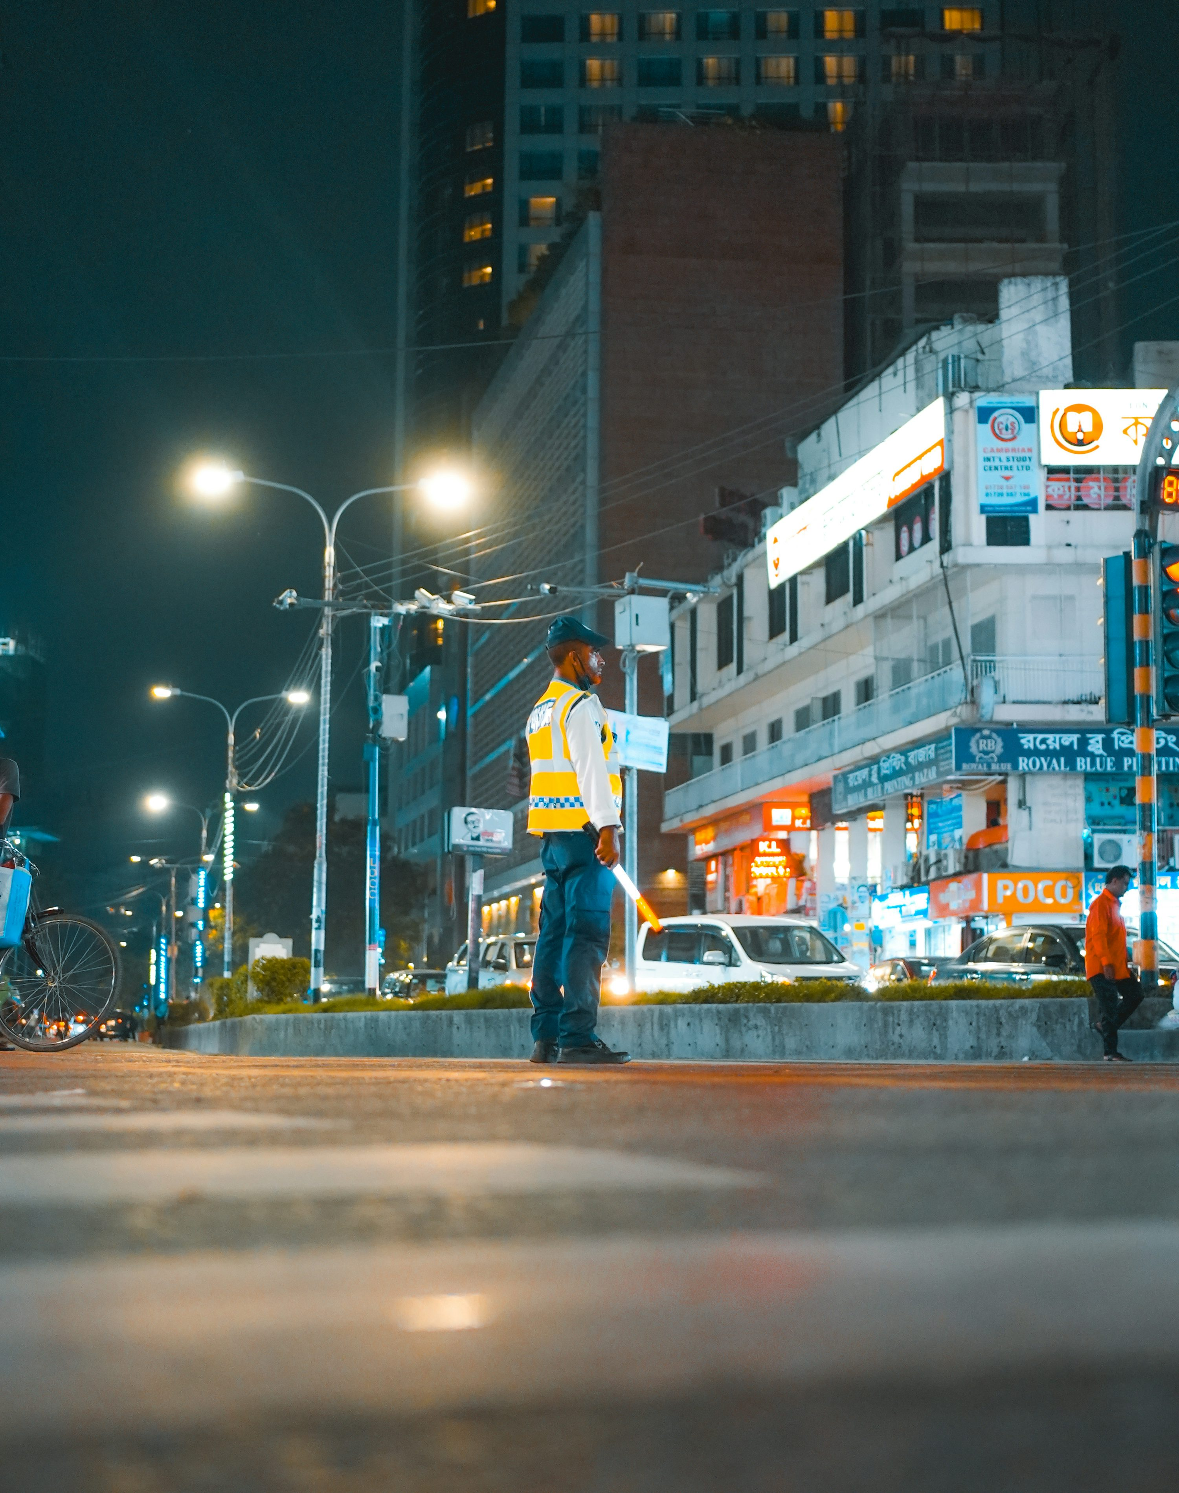
Market Size & Opportunity
Target Market:
40M+ households across Bangladesh
500K+ commercial and industrial entities
Addressing Critical Infrastructure:
Water supply networks serving major urban centers
Electricity distribution covering 3.5 crore connections
Gas utility systems with documented 7.67% losses
Corruption Elimination:
Evidence that "meter inspectors in collusion with WASA officials show less reading and provide illegal connections in exchange for illegal financial benefits" (The Business Standard, 2022)
CLIX removes human intervention points that enable corruption

Slide 19
Survey Analytics
Feature4 | Highly Helpful | Helpful | Neutral | Not Helpful | Not Helpful at all
Emergency gas leak alert at night | 88.60% | 10.10% | 0.00% | 0.00% | 1.30%
Real-time electricity bill tracking | 67.10% | 29.10% | 3.80% | 0.00% | 0.00%
Water leak alert when away from home | 70.90% | 27.80% | 1.30% | 0.00% | 0.00%
One-click bill payment via mobile | 74.70% | 24.10% | 1.30% | 0.00% | 0.00%
Preventing payment for others' illegal connections | 74.70% | 24.10% | 1.30% | 0.00% | 0.00%
Load-shedding timing notifications | 75.90% | 20.30% | 3.80% | 0.00% | 0.00%
Integrated system for electricity, gas, water | 65.80% | 27.80% | 6.30% | 0.00% | 0.00%
Tech & job opportunities from smart systems | 72.20% | 24.10% | 3.80% | 0.00% | 0.00%
Accurate billing with usage record | 75.90% | 17.10% | 6.30% | 0.00% | 0.00%
Disaster-time live utility map | 70.90% | 25.3% | 3.80% | 0.00% | 0.00%
Usage-based saving recommendations | 69.60% | 24.10% | 5.10% | 1.30% | 0.00%
Adoption of global smart utility models | 73.40% | 13.90% | 12.7% | 0.00% | 0.00%
Prior notification of utility personnel arrival | 65.80% | 22.80% | 10.10% | 1.30% | 0.00%
Knowing which appliances use the most electricity | 67.10% | 31.60% | 1.30% | 0.00% | 0.00%
Leaving reliable systems for future generations | 68.40% | 22.80% | 8.90% | 0.00% | 0.00%
Average | 72.07% | 23.00% | 4.65% | 0.17% | 0.09%
We collected 79 surveys (26 online, 53 offline). CLIX received "Highly Helpful" reviews from 72.07% of respondents, "Helpful" from 23.00%, "Neutral" from 4.65%, "Not Helpful" from 0.17%, and "Not Helpful at all" 0.09% of respondents.

Slide 20
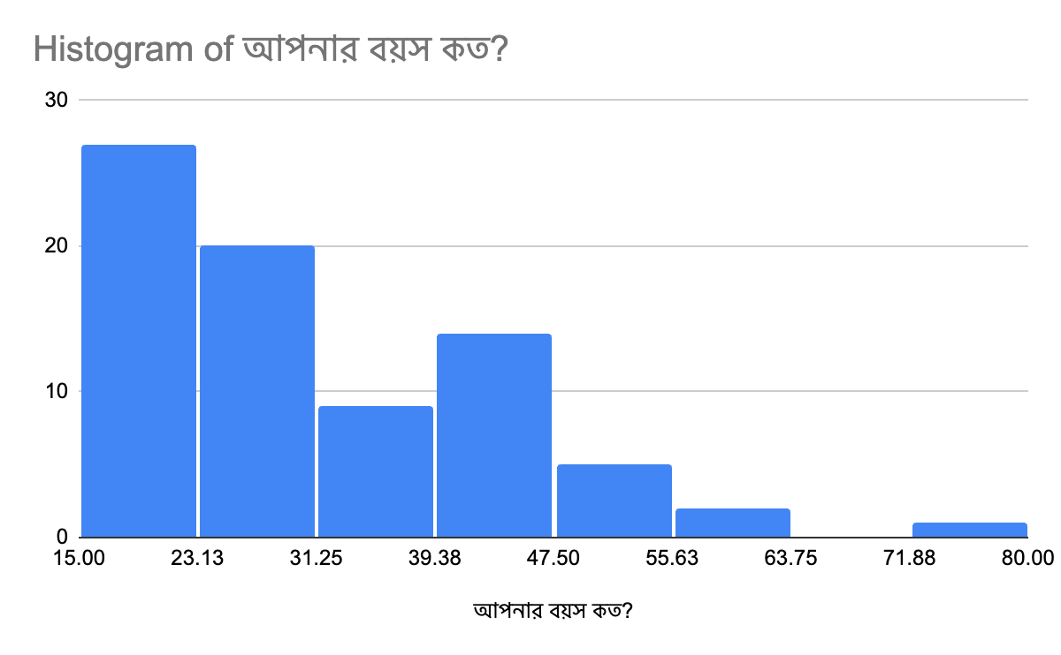
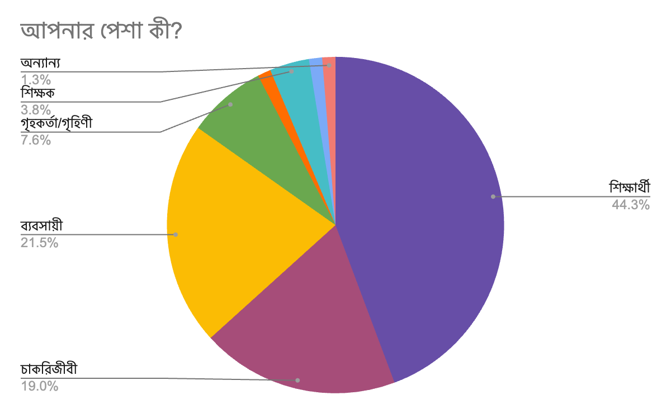
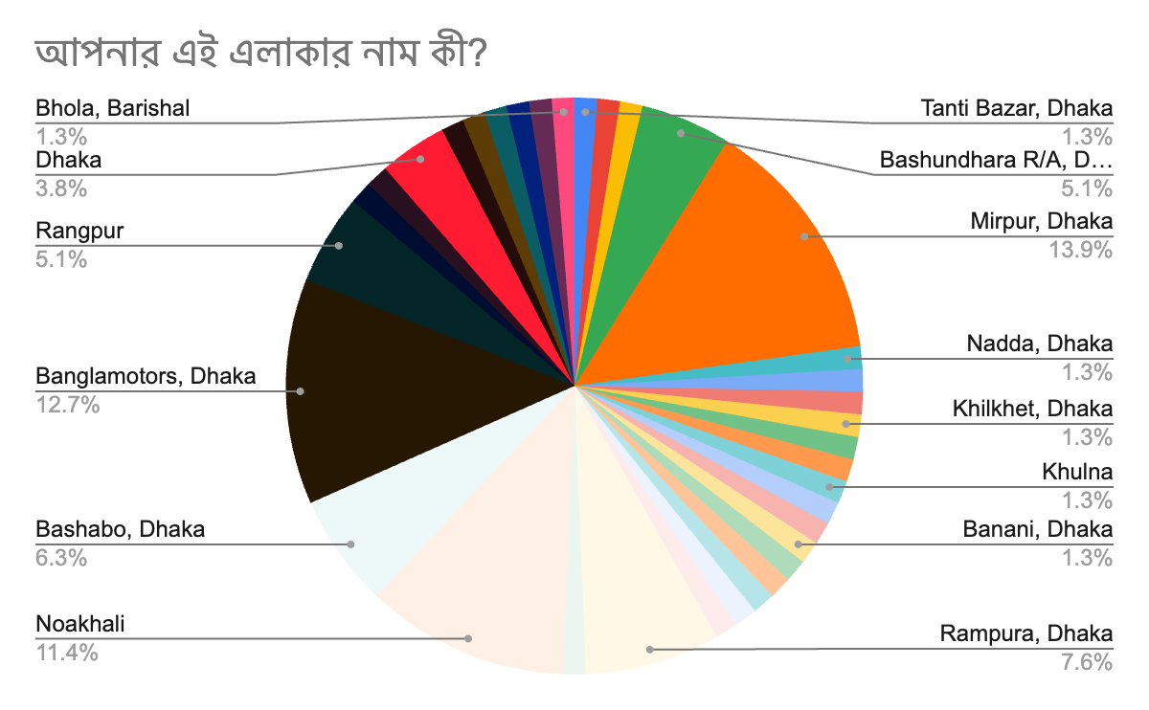
Survey Analytics
Occupation: 44.3% Student, 21.5% Businessman, 19.0% Service holder, 7.6% Householder, 3.8% Teacher & 3.8% Other
Area: Dhaka = 54.4% & Outside Dhaka = 45.6%
Age: 18-25: 35.4% (28 people), 26-35: 25.3% (20 people), 36-45: 19.0% (15 people), 46-55: 12.7% (10 people), 56-65: 6.3% (5 people) & 66+: 1.3% (1 person)

Slide 21
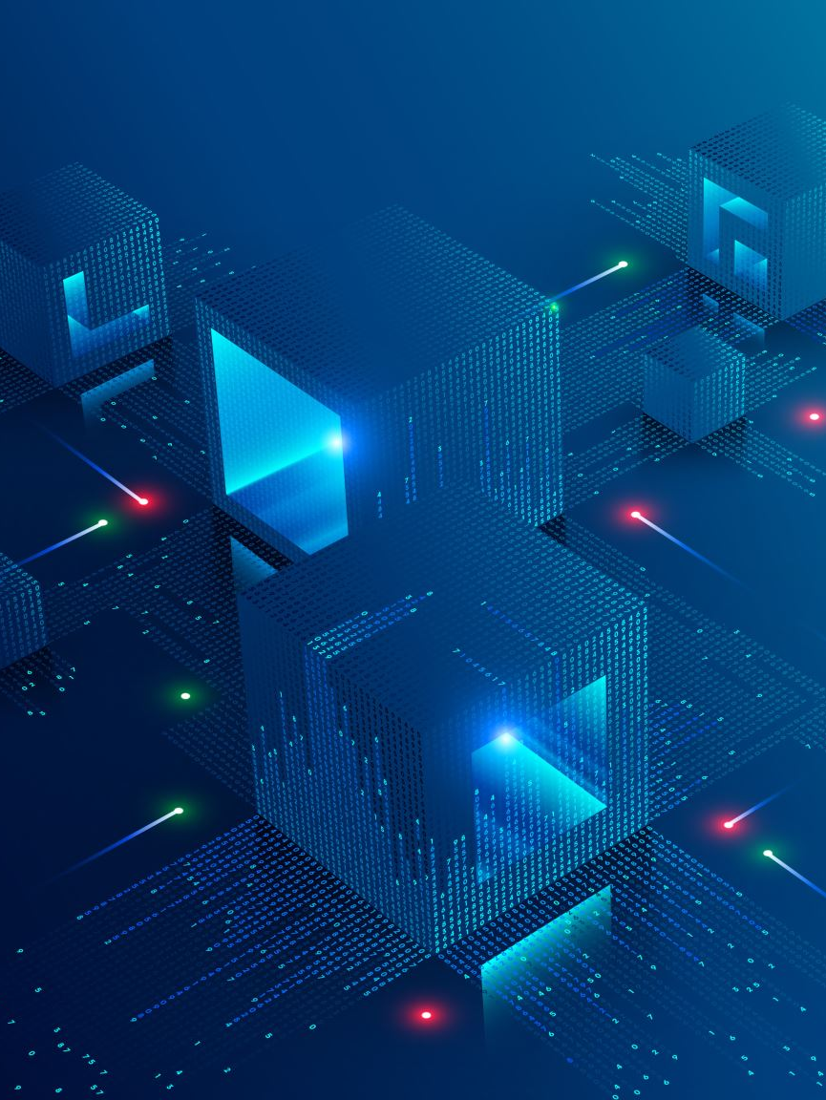
Implementation Plan
Comprehensive Project Lifecycle (36 months):
Research Phase (3 months): Needs assessment, regulatory compliance research
Design Phase (4 months): System architecture, UI/UX design, security protocols
Development Phase (6 months): Core components, integrations, analytics engines
Testing Phase (3 months): Quality assurance, performance testing, security validation
Pilot Deployment (3 months): 5,000 households in selected urban area
Full Deployment (12 months): Phased rollout to urban, suburban, and rural areas
Maintenance & Enhancement: Ongoing system support and improvement
Key Milestones:
Urban Deployment (Month 25): 100,000+ connections in major cities
Full Deployment (Month 31): Nationwide coverage of target areas

Slide 22

Sustainability & Revenue Model
Customer-Based Revenue: Utility providers will share a portion of their revenue with CLIX.
Enterprise-Based Revenue: CLIX will provide advanced monitoring systems to enterprise users. These users will pay utility providers, and CLIX will receive a share of this revenue. Additionally, CLIX will earn income through subscription fees.

Slide 23

Call to Action
Why Invest in CLIX:
Building on proven success of Chattogram WASA's smart meter pilot
Comprehensive implementation plan with clear milestones
Multiple revenue streams ensuring long-term sustainability
Key Impact Quote: "We are losing more than Tk45 crore in revenue every year [just in Chattogram]. WASA officials hope that digital meters can prevent this wastage and corruption." (The Business Standard, 2022)

Slide 24

Thank You
"The people who are crazy enough to think they can change the world are the ones who do." - Steve Jobs

